Slide 1


Department of Artificial Intelligence and Data Learning
Automated Lighting and Ventilation Control System
ARAVINTH
(221801003)
LIO GODWIN
(221801029)

Slide 2
Introduction
In our daily lives, forgetting to turn off lights and fans can lead to unnecessary energy waste and higher electricity bills. To solve this problem, we’ve developed an automated system that uses sensors to control lighting and ventilation in a room. By using the RCWL-0516 microwave radar sensor to detect motion, the system automatically turns the lights on or off based on whether someone is present. A second sensor controls the fan, ensuring it runs only when needed. This simple and cost-effective solution not only makes our homes more convenient but also helps save energy and reduce costs.

Slide 3
PROBLEM STATEMENT
In indoor environments, lighting and ventilation systems are often left running unnecessarily due to human oversight, leading to significant energy waste and increased operational costs. Traditional lighting and ventilation controls lack the responsiveness required to adjust based on real-time occupancy and environmental conditions, resulting in inefficient energy use and suboptimal environmental comfort. This issue is particularly pronounced in high-usage spaces such as residential, commercial, and educational settings, where manual intervention is often needed to turn off lights or adjust ventilation. As a result, there is a need for a system that can autonomously manage these elements to reduce power consumption, lower costs, and provide a comfortable indoor environment.

Slide 4
OBJECTIVE
The objective of the Automated Lighting and Ventilation Control System project is to:
Develop an nergy-efficient system that optimizes indoor lighting and ventilation by automating their control.
Utilize the RCWL-0516 microwave radar sensor for real-time motion detection, ensuring lights activate only when occupancy is detected.
Integrate temperature and humidity sensors to control ventilation, engaging the fan only when environmental conditions exceed preset thresholds.
Minimize manual intervention through a responsive dual-sensor setup, enabling real-time adjustments that reduce unnecessary power consumption.
Design a scalable framework suitable for various settings, including residential, commercial, and educational facilities, promoting sustainable energy practices and supporting smart building development.

Slide 5
Existing Systems
Manual Control: Lighting and fans are typically operated manually via physical switches, relying on users to turn them on or off as needed.
Energy Inefficiency: Manual operation often leads to energy waste, as lights and fans are frequently left on in unoccupied rooms or when not needed.
Basic Automation: Some existing systems use wifi and blutooth modules to automate lighting or fan control, but these are usually limited to controlling one device at a time.
Lack of Integration: Existing automated systems often lack integration, meaning they do not simultaneously manage multiple devices or adapt to varying environmental conditions.
Suboptimal User Experience: Current systems may not provide optimal energy savings or user comfort due to their limited flexibility and adaptability.
Complex Installation: Automated systems in place may be more expensive and complicated to install, especially in older buildings or homes.

Slide 6
Advantages and Disadvantages of Existing System
ADVANTAGE:
Simplicity: Manual switches are straightforward to use and require no technical knowledge, making them accessible to everyone.
Low Cost: Traditional systems with manual switches are inexpensive to install and maintain, with no need for complex technology or sensors.
Basic Automation: Some existing systems offer basic automation, like motion sensors or timers, which can reduce energy usage in certain situations.
Reliability: Manual systems are generally reliable, with fewer points of failure compared to more complex automated systems.
DISADVANTAGE:
Energy Inefficiency: Lights and fans are often left on unnecessarily, leading to significant energy waste and higher electricity bills.
Inconvenience: Manual operation requires users to remember to turn devices on or off, which can be inconvenient and prone to human error.
Limited Automation: Basic automated systems often control only one device at a time and lack integration, reducing their effectiveness in managing overall energy consumption.
Lack of Adaptability: Existing systems do not adapt to changes in environmental conditions or user presence, resulting in suboptimal comfort and energy savings.

Slide 7
Proposed System
The proposed system is designed to automate lighting and ventilation control in residential and commercial spaces, enhancing energy efficiency. It utilizes the RCWL-0516 microwave radar sensor to detect motion and automatically manage the room's lighting. When motion is detected, the lights turn on, and if no movement is sensed after a set period, the lights turn off, reducing energy waste.
Additionally, a secondary sensor will control the fan based on environmental conditions or human presence, ensuring it operates only when necessary. This system is easy to install and integrates seamlessly into existing electrical setups. It offers a cost-effective and user-friendly solution, minimizing the reliance on manual switches and contributing to a more energy-efficient and comfortable environment.

Slide 8
Advantages of Proposed System
Advantages of the Proposed System
Energy Efficiency: The system reduces unnecessary energy consumption by automatically turning off lights and fans when they are not needed, leading to lower electricity bills and reduced environmental impact.
Convenience: By automating lighting and fan control based on human presence, the system eliminates the need for manual operation, making it more convenient for users, especially in high-traffic areas.
Cost-Effective: Utilizing affordable sensors like the RCWL-0516, the system offers a budget-friendly solution for smart home automation, making it accessible for a wide range of users.
Enhanced Comfort: The system ensures that lighting and ventilation are automatically adjusted according to the presence of people in the room, creating a more comfortable living or working environment.
Easy Installation: The system is designed for simple integration into existing electrical setups, allowing for quick and hassle-free installation without requiring significant modifications.
Reliability: With the use of reliable sensors, the system ensures consistent and accurate detection of motion and environmental conditions, providing dependable automation.

Slide 9
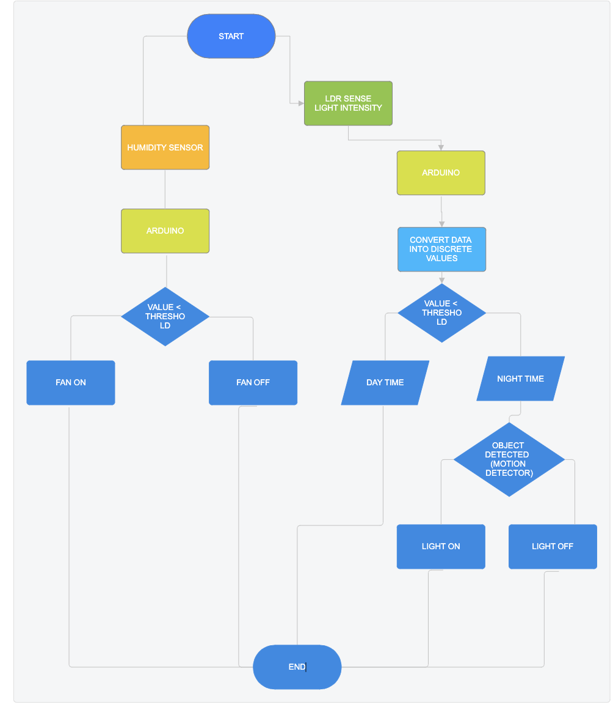
ARCHITECTURE DIAGRAM

Slide 10
HUMIDITY SENSOR MODULE
The humidity sensor shown in this circuit is the HIH-4000-001, a popular sensor that outputs an analog voltage directly proportional to the relative humidity. This sensor requires a 5V DC supply and provides a linear output voltage that represents the humidity level in the environment.
Circuit Explanation:
The HIH-4000-001 sensor outputs a small analog signal proportional to the relative humidity.
RL (82 kΩ) acts as a pull-down resistor, grounding the output signal.
The output from the sensor is fed into an operational amplifier (op-amp) configured as a non-inverting amplifier, amplifying the sensor’s output to a level suitable for the PIC ADC (Analog-to-Digital Converter).
R4 (1 kΩ) and R5 (317 Ω) set the gain of the op-amp, increasing the signal to a readable range for the ADC.
The op-amp is powered by a dual supply (+5V and -5V) to handle the small signals and ensure better accuracy in the amplified output.

Slide 11
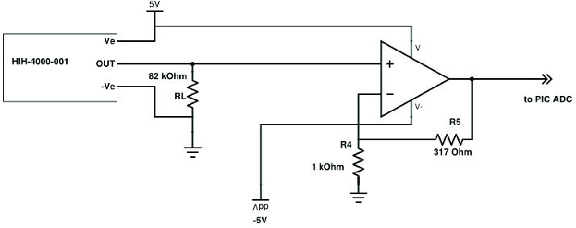
HUMIDITY SENSOR MODULE

Slide 12
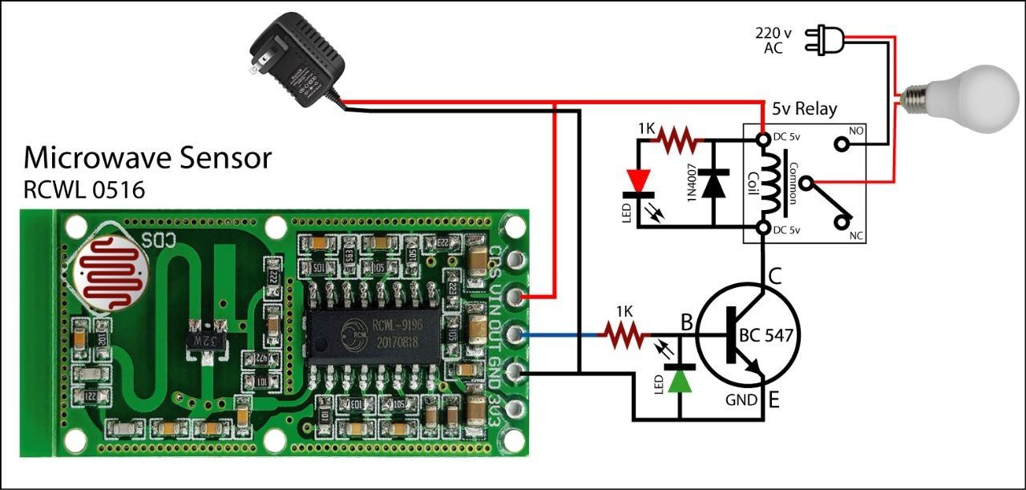
MICROWAVE SENSOR MODULE

Slide 13
MICROWAVE SENSOR MODULE
The RCWL-0516 Microwave Sensor is a motion detection sensor that uses Doppler radar technology to detect movement within its range. It can sense through various materials (like glass or thin walls), making it ideal for applications where PIR sensors may not work as well. This sensor outputs a high signal when motion is detected.
Circuit Explanation:
The RCWL-0516 sensor detects motion and outputs a signal to the base of a BC547 NPN transistor through a 1kΩ resistor.
When motion is detected, the transistor is activated, allowing current to flow from the collector to the emitter.
The transistor controls a 5V relay, which can switch higher-voltage appliances. In this case, it switches a 220V AC lamp on or off.
LEDs are added with 1kΩ resistors to visually indicate the relay's status: one LED lights up to show motion detection, and the other to indicate the relay's operation.
A 1N4007 diode protects the circuit from voltage spikes caused by the relay.

Slide 14
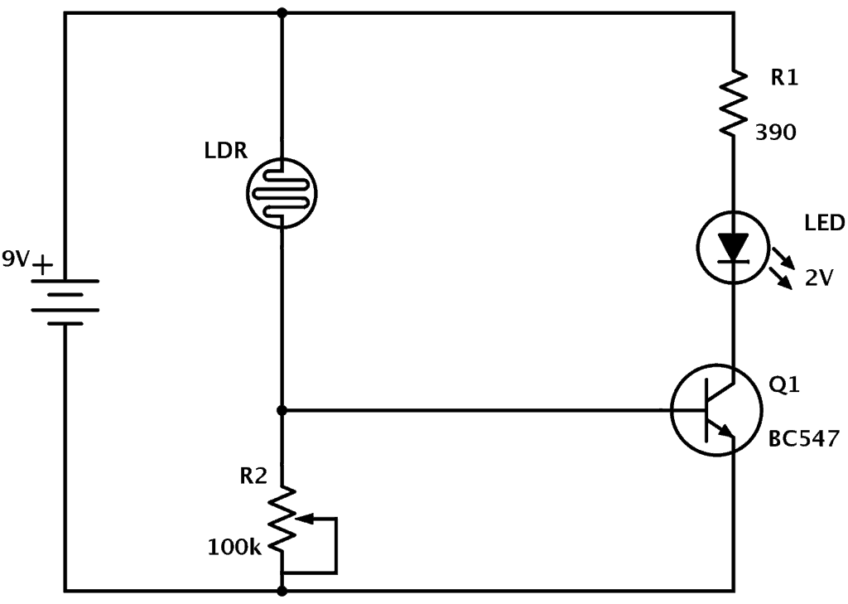
LDR MOTION SENSOR MODULE

Slide 15
LDR MOTION SENSOR
The Light Dependent Resistor (LDR) sensor in this circuit is used to detect light levels. An LDR's resistance decreases when exposed to light and increases in darkness, making it suitable for light-sensing applications.
Circuit Explanation:
The circuit is powered by a 9V battery.
The LDR is connected in series with a variable resistor (R2, 100kΩ), creating a voltage divider. This allows adjusting the sensitivity of the circuit to different light levels.
When there is low light (dark conditions), the LDR’s resistance is high, increasing the voltage across the base of the NPN transistor (Q1, BC547).
The base voltage turns on Q1, allowing current to flow from the collector to the emitter, lighting up the LED.
R1 (390Ω) limits the current through the LED to protect it from excess current.

Slide 16
Testing Types Overview
Integration Testing:
Verifies component interaction.
This verifies that the individual hardware and software components (e.g., sensors, control modules) work together seamlessly. For instance, it checks if the occupancy sensor correctly triggers the lighting control and if the environmental sensor activates the ventilation system when necessary.
Unit Testing:
Tests each component's functionality in isolation.
This tests each function independently, such as reading sensor values or controlling individual devices (like turning lights on/off). It ensures that each component performs as expected in isolation before they are integrated.
Benefits:
Early Detection of Issues: By identifying bugs and mismatches in both individual and combined functionalities, these tests prevent system failures and ensure smooth operation under real-world conditions.
Improved Reliability and Performance: Thorough testing of each unit and their interactions ensures a stable system, enhancing its ability to respond promptly to occupancy and environmental changes, thereby improving user experience and energy efficiency.

Slide 17
Integration Testing - Code
CODE:
void test_integration_temperature_and_fan() {
int temp = read_temperature();
const char* fan_status = check_fan_status(temp);
if (temp > 30) {
assert(fan_status == "Fan On");
} else {
assert(fan_status == "Fan Off");
}
printf("Integration Test Passed: Temperature and Fan interaction works as expected.\n");
}

Slide 18
Unit Testing - Code
CODE :
void control_light(bool motion) {
if (motion) {
printf("Light ON: Motion detected.\n");
} else {
printf("Light OFF: No motion detected.\n");
}
}
void test_light_control_on_motion() {
bool motion = detect_motion();
control_light(motion);
}

Slide 19
Challenges and Solutions
Challenges:
Hardware-software integration
Ensuring real-time response
Managing energy efficiency
Solutions:
Effective sensor calibration
Real-time testing tools.

Slide 20
Development Model - V-Model
Why V-Model?
Emphasis on Verification and Validation: The V-Model's structure includes testing activities in parallel with each development phase, allowing early detection and correction of defects. This is essential for a system that relies on both hardware and software to perform accurately in real-time.
System Reliability: The V-Model’s systematic approach ensures that each module is verified before integration. Since the project involves precise sensor interactions and control mechanisms, this model helps build a highly reliable and responsive system.
Clear Requirements and Test Planning: The V-Model requires detailed requirements and planning for each phase, which means well-defined testing criteria are established early. This makes it easier to verify that lighting and ventilation responses align with specific occupancy and environmental conditions.
Reduced Risk of Integration Issues: Integration testing is planned as part of each development stage. This reduces the risk of integration issues that might arise when combining hardware components, like sensors, with software logic.

Slide 21
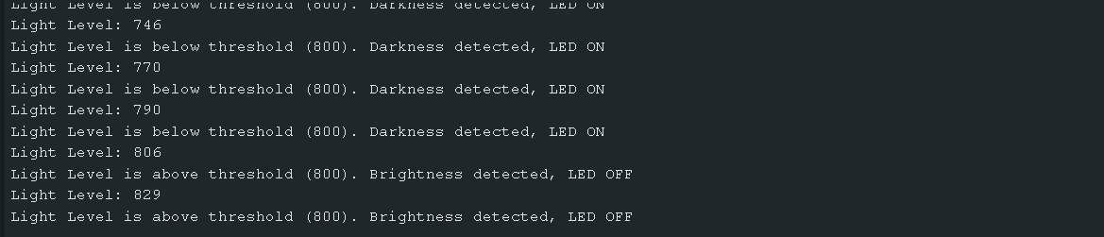
PROGRAM OUTPUT

Slide 22
UNIT TESTING OUTPUT

Slide 23
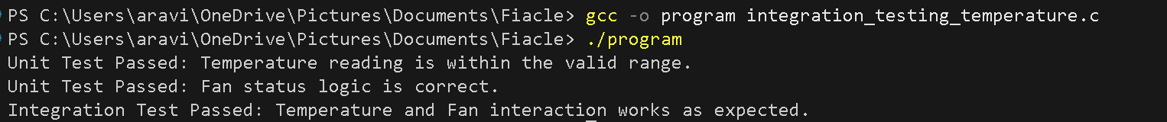
INTEGRATION TESTING OUTPUT

Slide 24
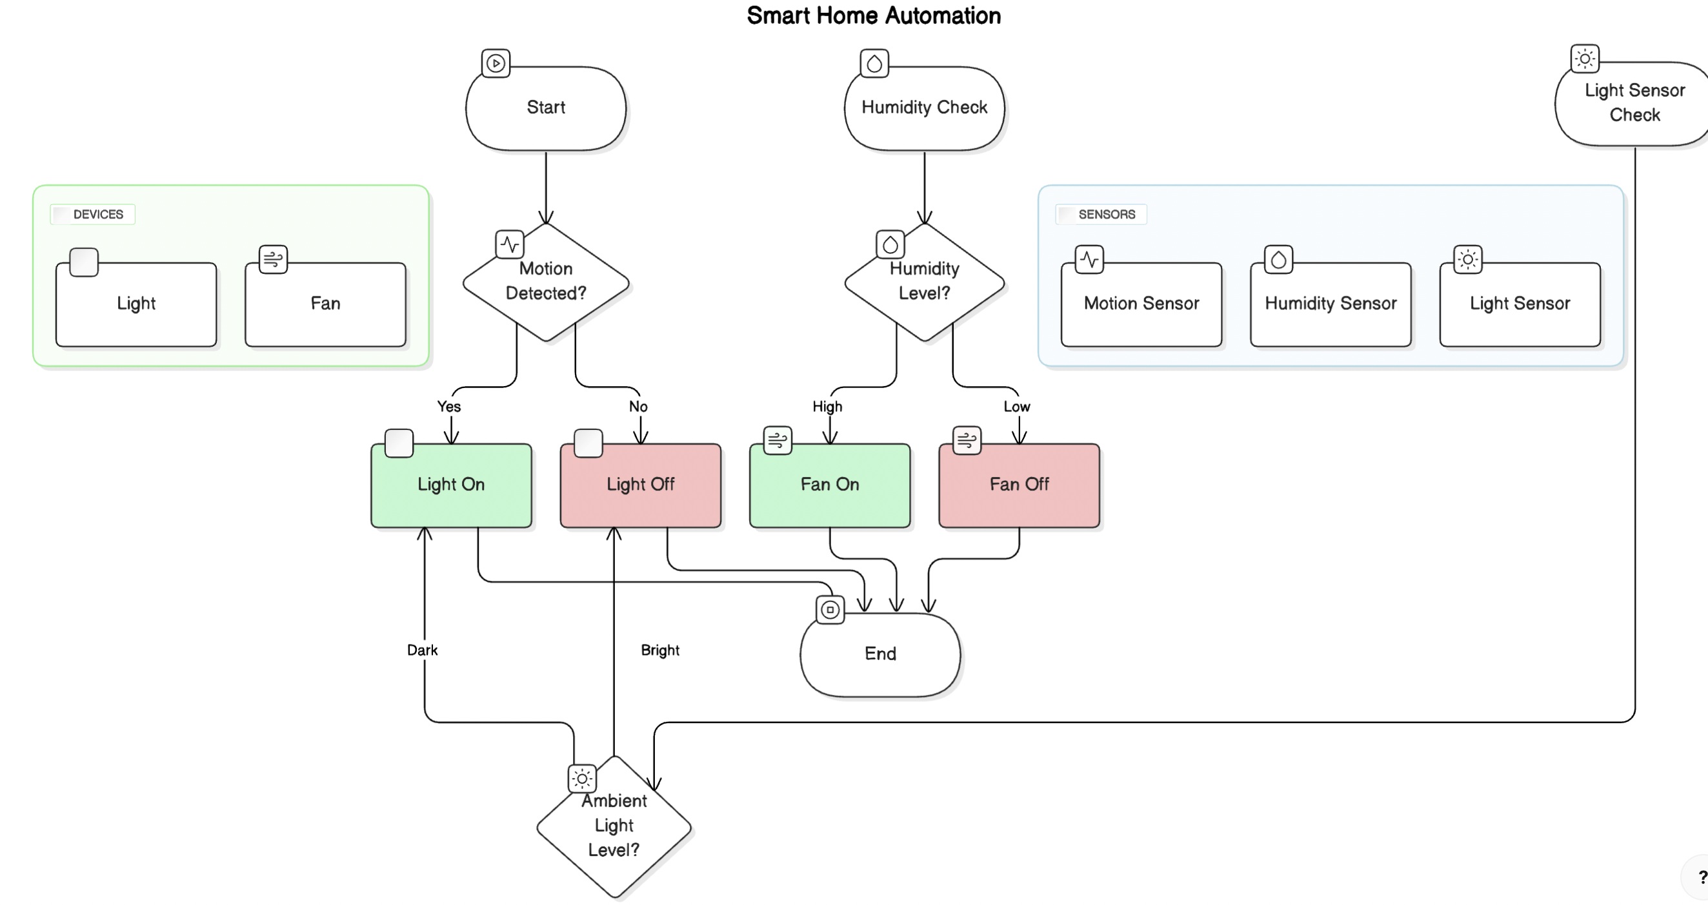
DATA FLOW DIAGRAM

Slide 25
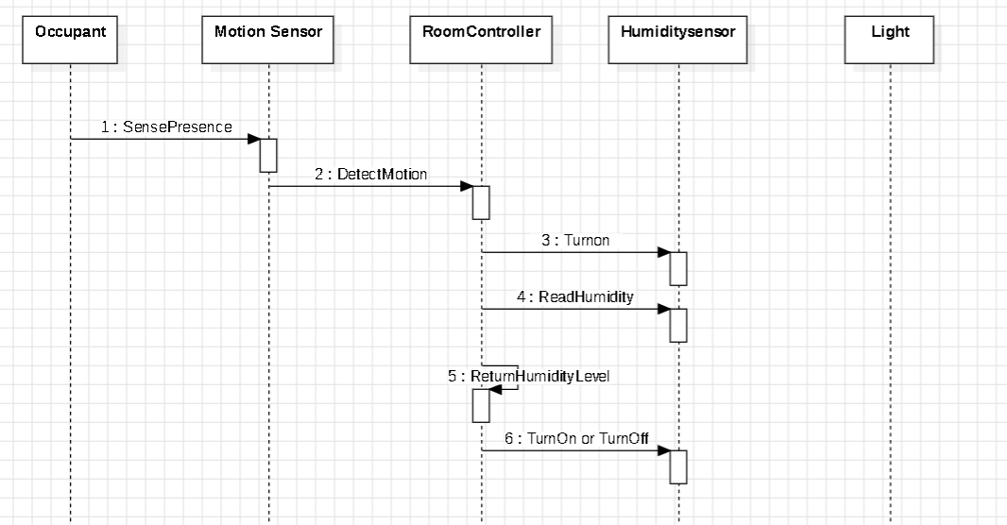
SEQUENCE DIAGRAM

Slide 26
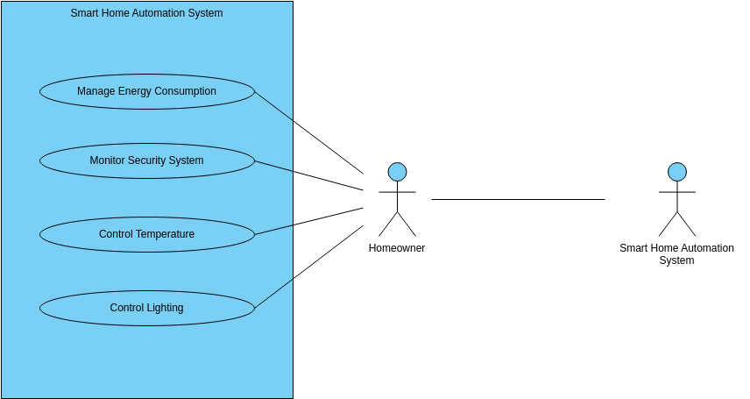
USECASE DIAGRAM

Slide 27
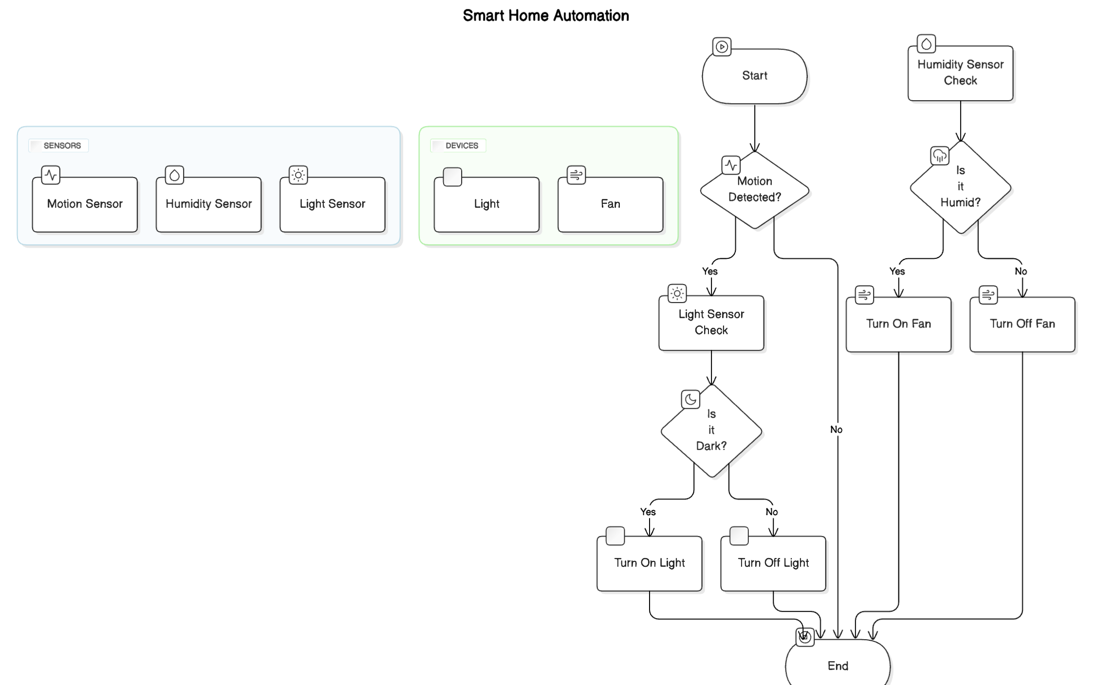
ACTIVITY DIAGRAM

Slide 28
References
[1] Abergel T, Dean B, Dulac J. Towards a zero-emission, efficient, and resilient buildings and construction sector: Global Status Report 2017. UN Environment and International Energy Agency: Paris, France. 2017. [2] https://www.iea.org/reports/global-energy-review-2020/global-energy-and-CO2-emissions-in-2020. Accessed 9 July 2020. [3] Ahmad AS, Hassan MY, Abdullah H, Rahman HA, Majid MS, Bandi M. Energy efficiency measurements in a Malaysian public university. In international conference on power and energy 2012 (pp. 582-7). IEEE. [4] Hassan JS, Zin RM, Abd Majid MZ, Balubaid S, Hainin MR. Building energy consumption in Malaysia: an overview. Jurnal Teknologi. 2014; 70(7): 33-8. [5] Dudley B. BP statistical review of world energy. BP Statistical Review, London, UK.2016. [6] https://www.mgtc.gov.my/annualreport2019/. Accessed 9 July 2020. [7] Ministry of Energy, Green technology and water Malaysia. Green technology master plan Malaysia (2017-30). [8] Mansur TM, Baharudin NH, Ali R. Optimal sizing and economic analysis of self-consumed solar PV system for a fully DC residential house. In international conference on smart instrumentation, measurement and application 2017 (pp. 1-5). IEEE. [9] Ananda-Rao K, Ali R, Taniselass S, Baharudin NH. Microcontroller based battery controller for peak shaving integrated with solar photovoltaic. 4th IET clean energy and technology conference 2017. [10] https://www.iea.org/policies/124-national-energy-efficiency-action-plan-4-2017-2020. Accessed 9 July 2020. [11] Tenaga S. Guidelines on no-cost and low-cost measures for efficient use of electricity in buildings. Suruhanjaya Tenaga (Energy Commission). 2014. [12] File M. Commercial buildings energy consumption survey (CBECS). US Department of Energy: Washington, DC, USA. 2015. [13] Wagiman KR, Abdullah MN, Hassan MY, Radzi NH. A review on sensing-based strategies of interior lighting control system and their performance in commercial buildings. Indonesian Journal of Electrical Engineering and Computer Science. 2019; 16(1):208-15. [14] Imam MT, Afshari S, Mishra S. Smart lighting control systems. In intelligent building control systems 2018 (pp. 221-51). Springer, Cham. [15] Firdaus R, Mulyana E. Smart building lighting system. In IOP conference series: materials science and engineering 2018 (pp. 1-7). IOP Publishing.

Slide 29
Thank You

